Slide 1
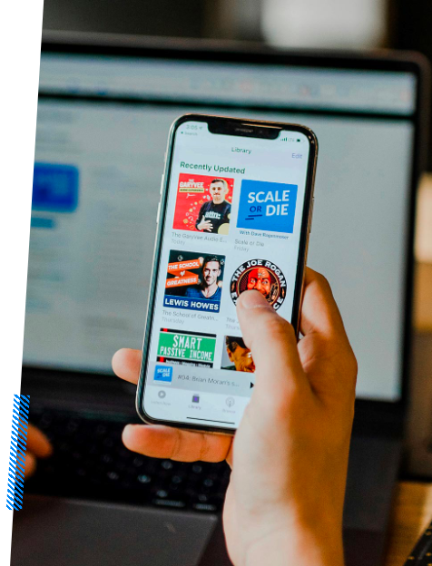
Introducing to College_Social
Let's make easy communication between professors and student

Slide 2
Team Members And Their Roles
ID | Name
730 | JADHAV HARSH PANDURANG
735 | BATE PRANAY MAHENDRA
736 | NITESH RAVINDRA SHINDE
746 | MESHRAM AYUSH PRADEEP
Project Guide : Mrs. Mamta Thakur

Slide 3
Language And Database
Frontend : Python ( kivy ) - Kivy is a python library for creating apps
Backend : Python ( Django ) - Django is a popular python library
Database : we have used Sqlite3 database

Slide 4
Project's Major Parts
Database Design
Frontend Devlopment
Interface Design
Backend Devlopment

Slide 5
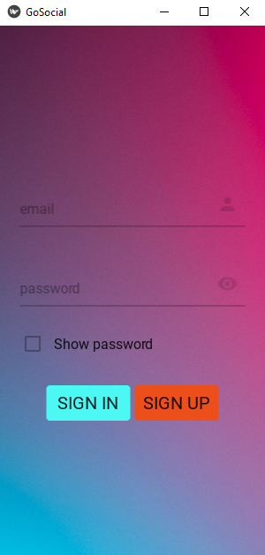
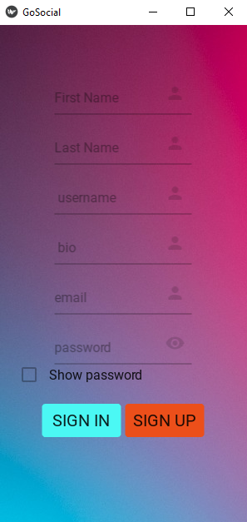
Login/Register Interface (APP)

Slide 6
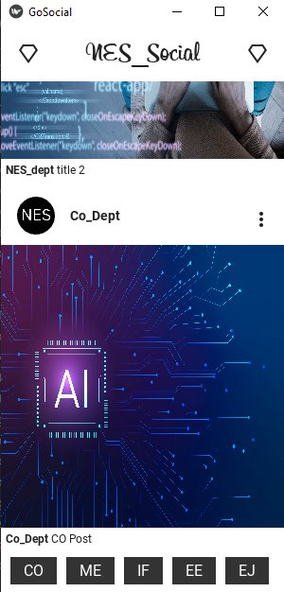
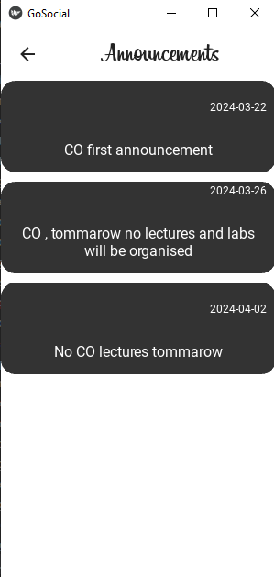
Posts And Announcement Interface
Announcement page
Announcement text
Name of department posted the post
Post image
Description of post
Buttons which takes you to announcement page of particular department

Slide 7
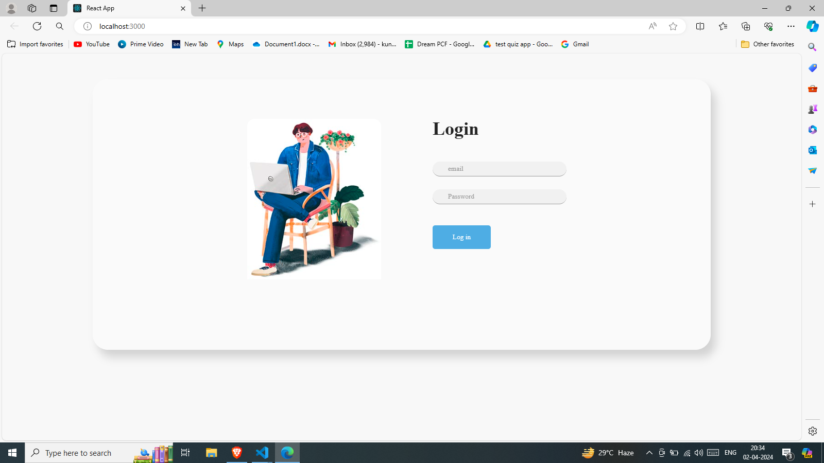
Admin Panel ( for professors )
Login interface for professors . Here there are 5 accounts for particular departments if someone logins with account of CO department he will be taken to home page of co department from there he/she can post and upload announcements which will be updated with the username as CO_Dept .

Slide 8
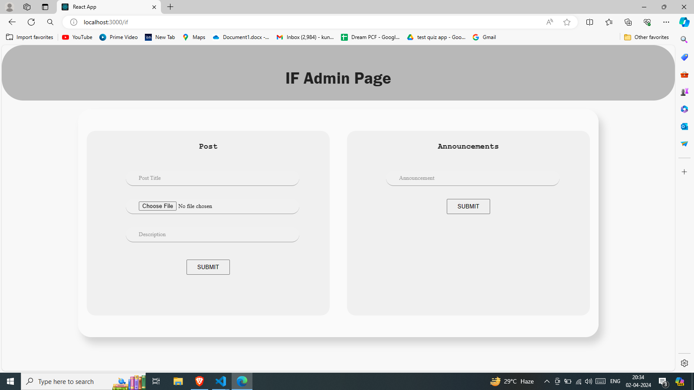
Home page of admin panel (IF department)
From here you can upload posts , you have to give title , select an image and description .
From here you can post announcement , you have to just write the announcement and submit

Slide 9
Database Models
Users
First_name
Posts
description
Announcements
Title
Last_name
password
Email
username
Image
department
Text

Slide 10
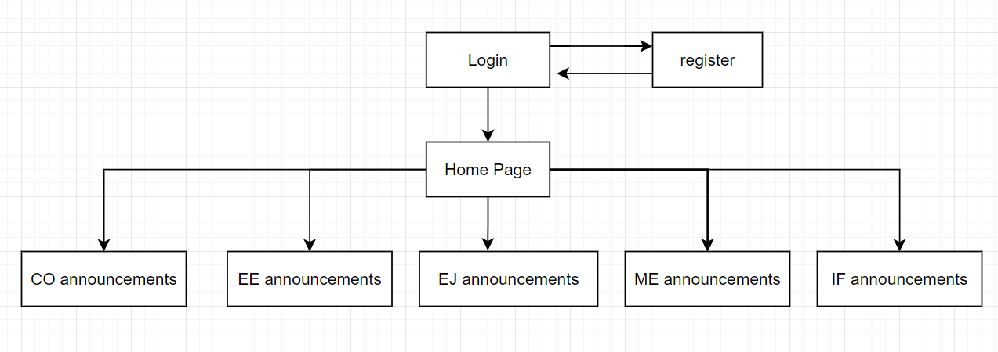
Flowchart ( APP )

Slide 11
Thank You

